Slide 1
“Copernicus Artificial Intelligence (AI) Services and data fusion with other distributed data sources and processing at the edge to support DIAS and HPC infrastructures”
Project Overview
This project has received funding from the European Union's Horizon 2020 research and innovation programme under grant agreement No 101004152.

Slide 2
The Challenge
Europe’s sustainable economic growth and societal wellbeing can benefit incredibly from the exploitation of Earth Observation (EO) data. Even though many sectors could profit from them, accessing and utilising EO data is not an easy task. Examples of such sectors constitute ones relevant to policymaking, water management, journalism and border security.
Barriers in using of EO data in different sector
Vast amount of data
Heterogeneity
Difficult accessibility
Necessity of experts to use and interpret them
practical problems in using EO data
time consuming
higher costs
special knowledge & skills required

Slide 3
Project Facts
CALLISTO - “Copernicus Artificial Intelligence (AI) Services and data fusion with other distributed data sources and processing at the edge to support DIAS and HPC infrastructures”
Research and Innovation Action
Call H2020-SPACE-2020
Topic: “Big data technologies and Artificial Intelligence for Copernicus”
Coordinator
Duration: 01/01/2021 – 31/12/2023 (36 months)
Grant Amount: 3,999,953.75 €

Slide 4
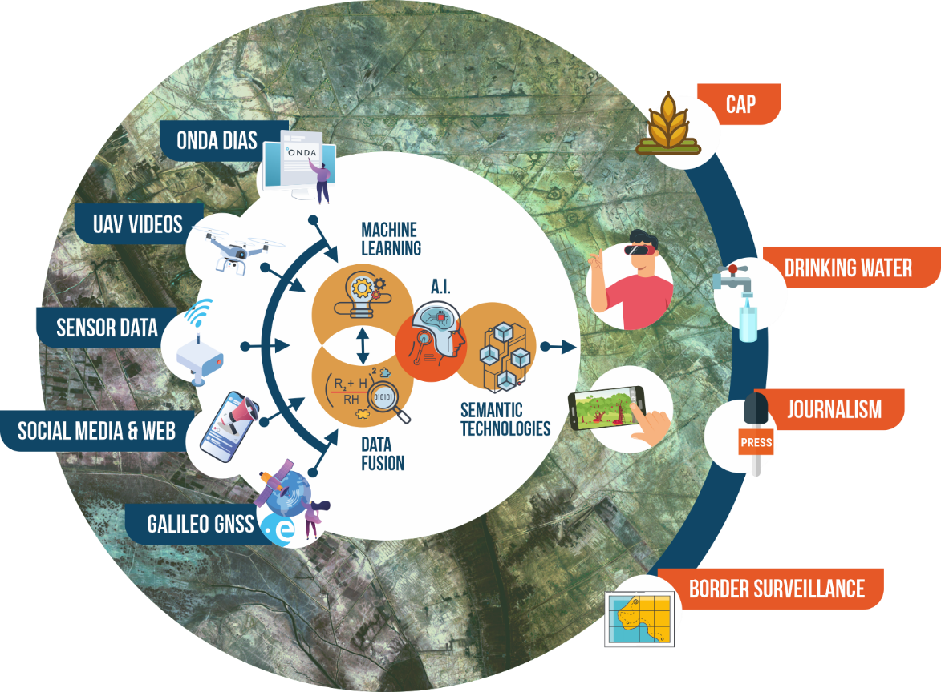
The CALLISTO solution
CALLISTO utilises Machine Learning & Data Fusion technologies to combine Earth Observation data from ONDA DIAS with data from heterogeneous distributed sources (crowdsourced data, UAV videos, data from in-situ sensors).
The outcomes are served to the public in interactive interfaces, and mobile and Mixed Reality apps.
CALLISTO aims to bridge the gap between DIAS providers and data end-users through dedicated Artificial Intelligence solutions

Slide 5
CALLISTO’s Goals
Supporting the EC Destination Earth and ESA Digital Twin Earth; bridging the gap between the DIAS providers and the end users
Combining EO with crowdsourced data, videos from UAVs and in-situ data (using Machine Learning and Data Fusion); the outcomes are provided in interactive interfaces and mobile apps
Enabling virtual presence and situational awareness, through Virtual, Augmented and Mixed Reality
Focusing on CAP monitoring, water quality assessment, satellite journalism and land border change detection

Slide 6
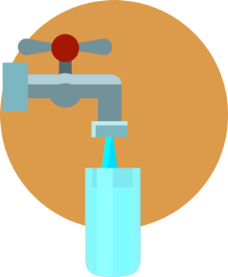
Pilot use cases
CALLISTO’s services will be pilot-tested for approximately 10 months in the following sectors:
Common Agricultural Policy (CAP) monitoring
Satellite Journalism
Virtual monitoring of the implementation of the Common Agricultural Policy (CAP) obligations.
Assessment of the reliability of the news that environmental journalists receive about pollution events.
Water quality assessment
Land border change detection
Virtual presence in water resources for water quality assessment using EO and in-situ data.
Improving the existing approaches and increasing the value of the current Border Surveillance Services.

Slide 7
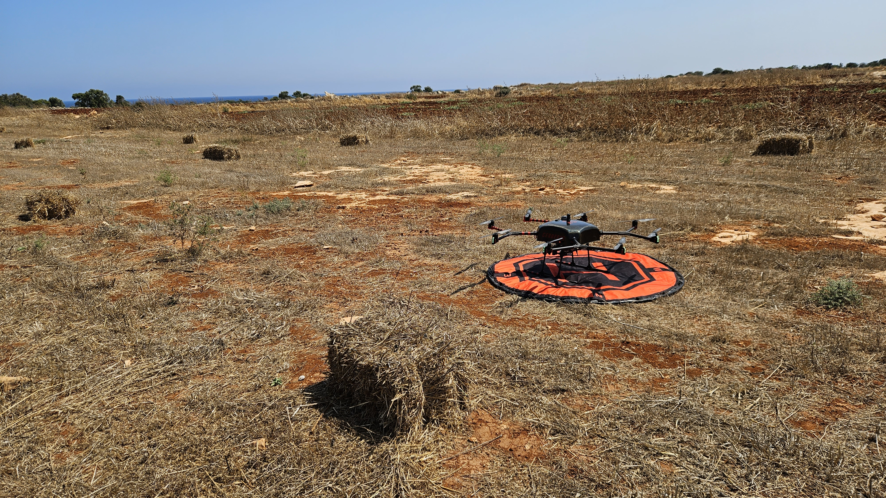
PUC1 - CAP Monitoring
Scope
Allowance of virtual presence for CAP obligations monitoring (CALLISTO enables targeted on-the-spot checks and evidence-based decision making)
Stakeholders
farmers + policymakers
Data
Sources: Sentinel 1, Sentinel 2, UAV mounted sensor
The data are interpreted using AI technologies (deep learning models; inference at the edge) and provided to stakeholders on an interactive platform and a mobile app
Impact
Increase of transparency, efficiency and scalability of the CAP inspection processes towards exhaustive monitoring and the priorities of the new CAP
PUC1 Demonstration, Cyprus (June 2023)

Slide 8
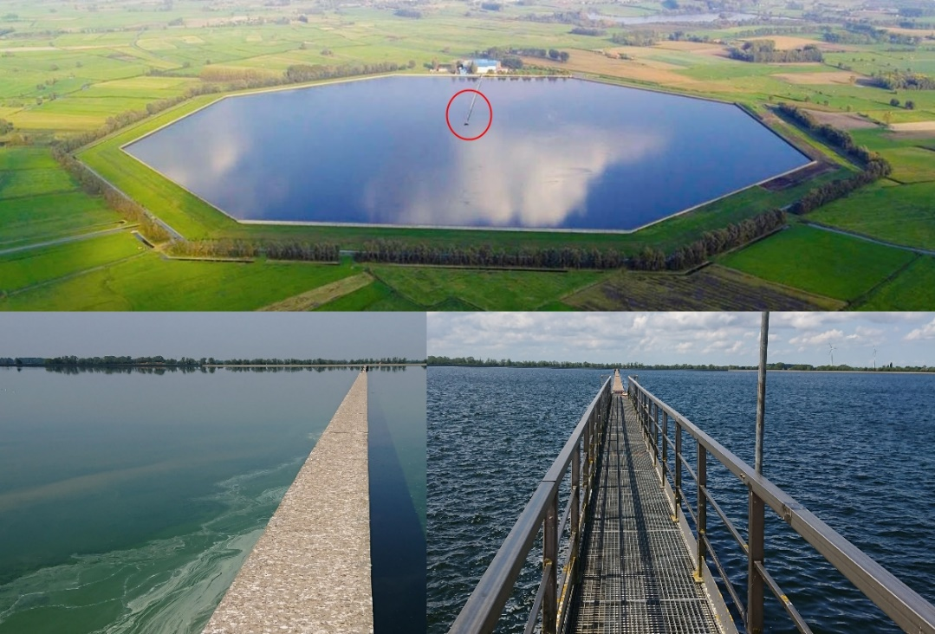
PUC2- Water Quality Assessment
Scope
Assessment of water quality (algae, hazardous materials or treatment by-products) and monitoring of surface water through virtual presence in the water resources
(De WaterGroep, SMAT)
Stakeholders
drinking water industry + water authorities
Data
Sources: in-situ measurements, Copernicus data, cameras mounted on UAVs
The data are collected, analysed and provided to stakeholders on an interactive platform
Impact
Tackle of the problem of the deteriorating raw water quality (increasing concern for future drinking water supply)
Raw water basin of WPC De Blankaart. Aerial view (top) with detailed view of the circled area (red) in May 2019 (right, normal) and August 2019 (left, algae bloom).

Slide 9
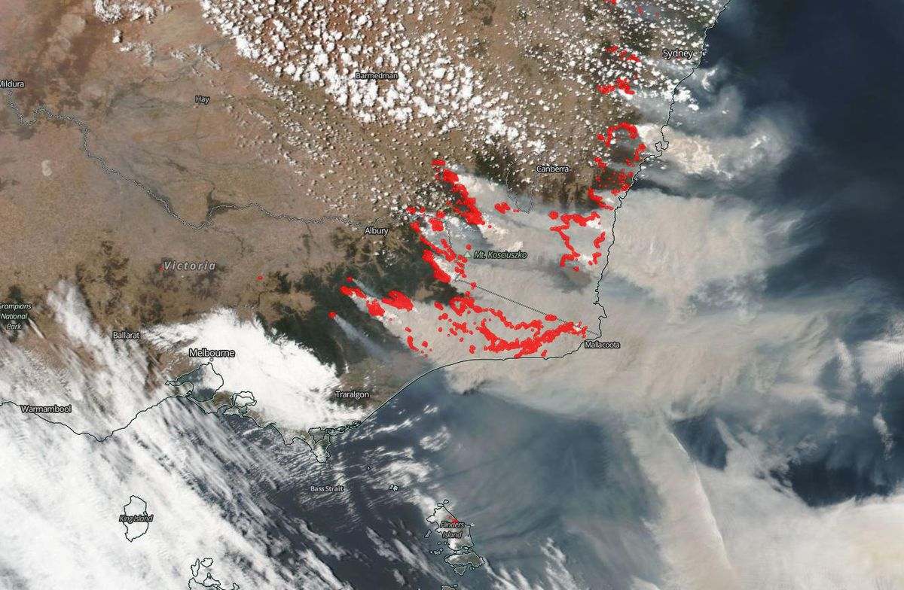
PUC3 – Satellite Journalism
Scope
Provision of satellite data contextualized and put into reference with information from multiple sources
Stakeholders
Media broadcasters + media companies + journalists
Data
Sources: satellites, sensors, information from traditional and social media
The EO data are combined and aggregated with other sensor data (e.g. from air, sea and ground measurement stations) and information from traditional and social media, and are provided to stakeholders through an easy-to-use monitoring tool
(1) The extent of bush fires as seen in Australia could only be really understood by looking at satellite imagery. Active fires are highlighted in red. NASA/NOAA
Source: https://www.vox.com/2020/1/3/21048700/australia-fires-2019-map-satellite-smoke-pollution
(2) Abstracting information and providing context of the spread of wildfires by using an infographic.
Source: https://p.dw.com/p/3iggO
Impact
Support of investigative journalism in the field of climate politics and increase of environmental awareness

Slide 10
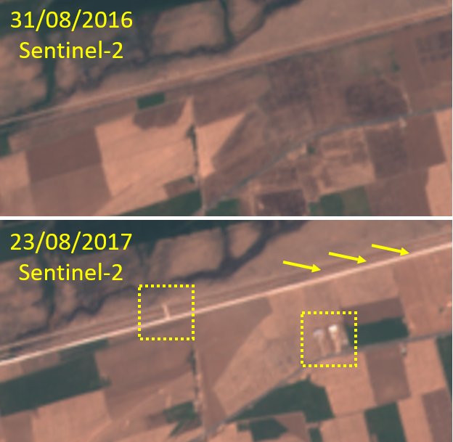
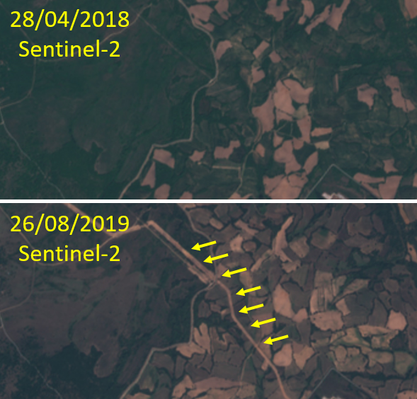
PUC4 - Land Border Change Detection
Scope
Detection of relevant land changes and provision of alerts that the operator can validate (operation at EU border scale)
Stakeholders
Security agencies
Data
Source: Sentinel-2
The data are processed with models able to recognise “relevant” (new buildings, barriers, roads) and “non-relevant” (snow cover alterations, agricultural crop stages) changes, based on proper user-centric definition.
Relevant changes manually detected near land borders with Sentinel-2 (true-colour RGB).
Impact
Increase of situational awareness to guarantee protection and security of EU citizens.

Slide 11
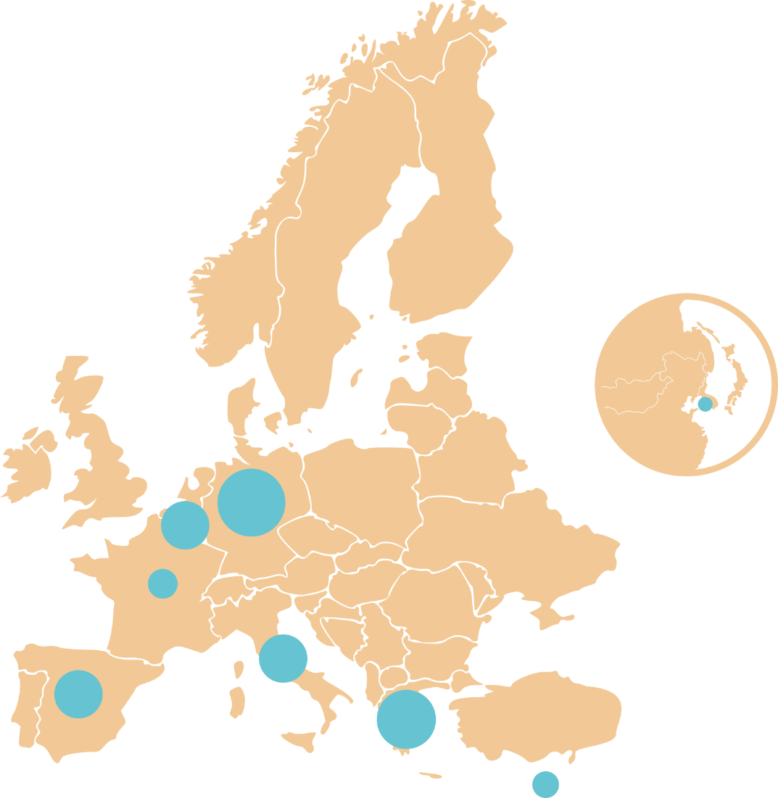
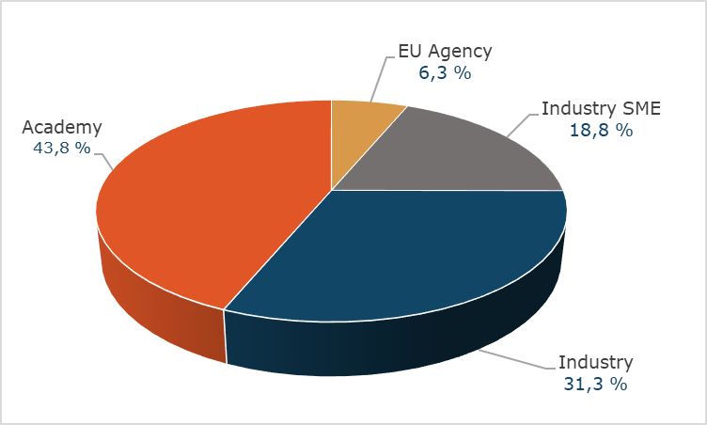
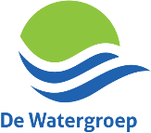
Consortium
17 partners
7 EU countries and South Korea

Slide 12
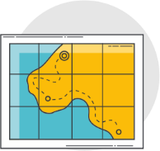
Roadmap
*M: Project month
1st evaluation cycle
Project
Start
M1
January 2021
M6 (MS1)
M12 (MS2)
M23 (MS3)
M25
Project set up
Platform Development Roadmap
First Prototype
Operational test for Water Quality Assessment
(De Watergroep)
2nd evaluation cycle
M30
M29
M28 (MS4)
Demo for CAP Monitoring (NOA)
Operational test for Sensor Journalism
(DW)
Second prototype
Project
end
M33
M34
M35
M36
December 2023
Final System
Demo for Land Border Change Detection
(SATCEN)
Demo for Water Quality Assessment
(SMAT)
3rd and final evaluation cycle

Slide 13
@CALLISTO_H2020
@callisto-h2020.eu
callisto-h2020.eu
Thank you!
You can contact us at info@callisto-h2020.eu
https://callisto-h2020.eu/
Eliana Li Santi
Project Coordinator
(SERCO)
eliana.lisanti@serco.com
Stefanos Vrochidis
Scientific and Technical Manager
(CERTH)
stefanos@iti.gr
Anastasios Karakostas
Innovation Manager
(DRAXIS)
akarakos@draxis.gr
This project has received funding from the European Union's Horizon 2020 research and innovation programme under grant agreement No 101004152.

